Slide 1
Wireless Networking Technologies

Slide 2
Taxonomy of wireless networking technologies
Wireless networks
LAN
MAN
WAN
PAN
WSN (sensor networks)
Cellular Networks
Ad-Hoc Networks

Slide 3
Personal Area Networks (PANs)
Intended for a single user
Bluetooth:
short distance comm. between small devices
InfraRed:
line-of-sight required, between small devices
ZigBee:
ZigBee is the only open, global wireless standard to provide the foundation for the Internet of Things by enabling simple and smart objects to work together
UWB (Ultra-wide band)
PC peripherals, radar, imaging
ISM wireless:
frequencies set aside for Industrial, Scientific and Medical devices, 3 ranges of freq.

Slide 4
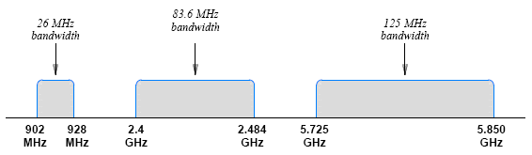
ISM Wireless Bands Used by LANs and PANs
A region of electromagnetic spectrum is reserved for use by Industrial, Scientific, and Medical (ISM) groups
Known as ISM wireless
Not licensed to specific carriers
available for LANs and PANs
Figure 16.3 (below) illustrates the ISM frequency ranges

Slide 5
Wireless LAN Technologies and Wi-Fi
A variety of wireless LAN technologies utilizing:
frequencies
modulation techniques
data rates
Standardized by IEEE as IEEE 802.11
Wi-Fi Alliance
a non-profit organization that tests and certifies wireless equipment using the 802.11 standards

Slide 6
Key wireless standards
IEEE standard | Frequency Band | Data Rate | Modulation and multiplexing techniques
Original 802.11 | 2.4GHz | 1 or 2 Mbps | DSSS, FHSS
 | 2.4GHz | 1 or 2 Mbps | FHSS
 | Infrared | 1 or 2 Mbps | PPM
802.11b | 2.4GHz | 5.5 to 11 Mbps | DSSS
802.11g | 2.4GHz | 22 to 54 Mbps | OFDM, DSSS
802.11n | 2.4GHz | 54 to 600 Mbps | OFDM

Slide 7
Spread Spectrum Techniques
Spread spectrum
the sender spreads data across multiple frequencies
the receiver combines the information obtained from multiple frequencies to reproduce the original data
Goals
Increase overall performance
Make transmission more immune to noise
The three key multiplexing techniques used in Wi-Fi wireless networks
FHSS
DSSS
OFDM

Slide 8
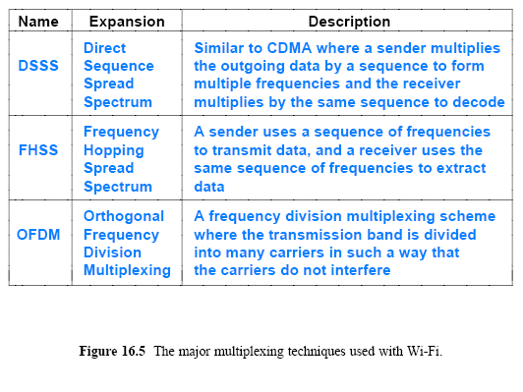

Slide 9
Other wireless standards
IEEE 802.11ah and 802.11af, runs at just 900MHz and will offer very poor data speeds, but works across huge areas. While WiGig will supercharge homes, it's IEEE 802.11ah that will fuel what should probably be renamed the Wi-Fi Internet of Everything
802.11e: improved QoS – low jitter
802.11i: enhanced security
802.11k: radio source management
802.11n: data rate over 100Mbps (multimedia)
802.11p: comm. Among vehicles on a highway
802.11r: improved roaming capability
802.11s: proposed for mesh network
802.11ac: use of 5GHz band. Max single link of 500megabits (up to 256 QAM)
802.11ad: “WiGig” use of 60GHz, up to 7Gbps
“microwave Wi-Fi”, ranges from 1 to 10 meters

Slide 10
Summary of Key Wi-Fi Standards:
Standard | Frequency Band | Max Speed | Main Features | Use Cases
802.11ax (Wi-Fi 6/6E) - 2019 | 2.4 GHz, 5 GHz, 6 GHz (6E) | 9.6 Gbps | OFDMA, MU-MIMO, 1024-QAM, BSS Coloring, TWT | IoT, smart homes, high-density environments
802.11be (Wi-Fi 7) | 2.4 GHz, 5 GHz, 6 GHz | 46 Gbps (theoretical) | 320 MHz channels, 4K-QAM, Multi-Link Operation | AR/VR, 8K streaming, enterprise environments
802.11ad (WiGig) | 60 GHz | 7 Gbps | High-speed, short-range, ideal for point-to-point communication | Wireless VR, HD media streaming, docking stations
802.11ay | 60 GHz | 176 Gbps (theoretical) | Enhanced range and speed over 802.11ad | 8K streaming, wireless data centers, VR
802.11ah (HaLow) | Sub-1 GHz (900 MHz) | 347 Mbps | Low power, long-range, IoT-focused | IoT, smart cities, industrial automation
802.11af (White-Fi) | TV White Spaces | 568 Mbps | Long-range, uses TV broadcast frequencies | Rural broadband, smart agriculture, IoT

Slide 11
Wireless LAN architecture
The three building blocks:
Access points (AP) – base station
An interconnection mechanism
A set of wireless hosts
two types of wireless LANs are possible:
Ad hoc
Infrastructure based
Application: AP throughout buildings

Slide 12
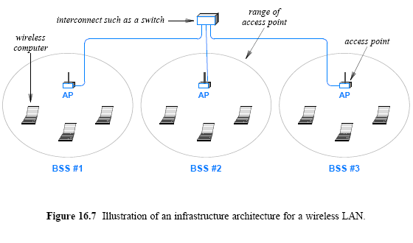
Basic service set

Slide 13
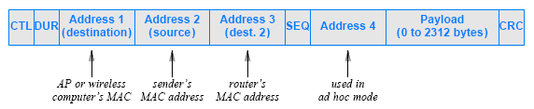
Overlap, Association, and 802.11 Frame Format
More than one access point – overlap
Area not covered by any access point – deadzone
Associate with only one access point
For internet access – needs router’s MAC address
CTL: Frame control (protocol version, type, etc)
DUR: Duration ID

Slide 14
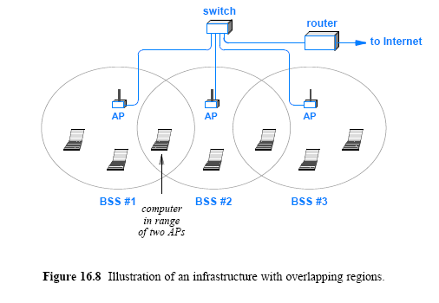
Handoff from weaker signal strength to stronger signal

Slide 15
Contention and Contention-Free Access
The original 802.11 standard defined two general approaches for channel access
Point Coordinated Function (PCF)
Distributed Coordinated Function (DCF) for contention-based service
BSS uses a random access protocol
Hidden station problem
802.11 networks use CSMA/CA
Exchange RTS and CTS messages before transmission

Slide 16
Contention and Contention-Free Access
The 802.11 standard defines three timing parameters as follows:
Short Inter-Frame Space (SIFS) of 10 (or 16 in 11n and 11ac) µsec
Time to wait before sending an ACK or other response
Distributed Inter-Frame Space (DIFS) of 50 (or 34 in 11n and 11ac) µsec
Time to idle before a station can attempt transmission
2 slot time plus SIFS
Slot Time of 20 (or 9 in 11a, 11n, 11ac) µsec

Slide 17
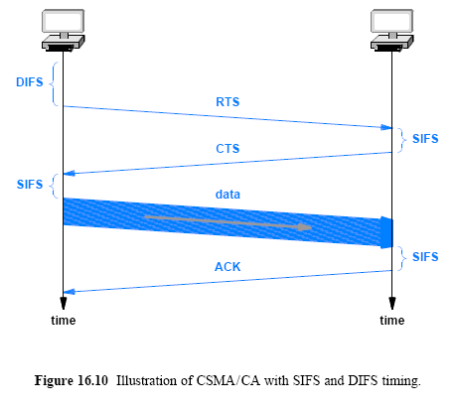

Slide 18
Wireless MAN tech and WiMax
IEEE standard 802.16
Fixed WiMAX – informally 802.16d
Doesn’t provide handoff among APs (service to a fixed location)
Mobile WiMAX – 802.16e-2005
Potential Usage
access
Last mile alternative to DSL or cable modem
As a backup for a site’s Internet connection
interconnect
Backhaul (conn. Between a service provider and remote cell tower)
Private connection (multiple sites of a company)
Connection between small and large ISPs
Comparison between WiMax and LTE
WiMAX: low cost, 4G based on the IEEE 802.16, largely overtaken by LTE and 5G
LTE-A: backward compatible, true 4G technology (max of 1Gbps)

Slide 19
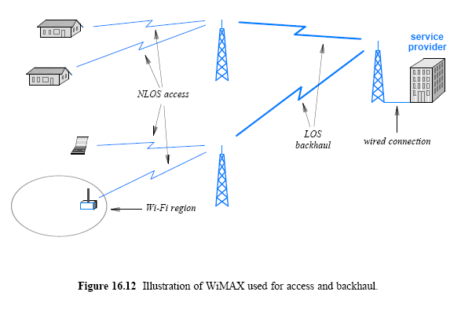
Wireless MAN Technology and WiMax
(Non-line-of-sight)
WiMax, LTE, 5G or MIMO

Slide 20
Wireless MAN Technology and WiMax
The key features of WiMAX can be summarized as follows:
Uses licensed spectrum (i.e., offered by carriers)
Each cell can cover a radius of 3 to 10 Km
Uses scalable orthogonal FDM
Guarantees quality of services (for voice or video)
Can transport 70 Mbps in each direction at short distances
Provides 10 Mbps over a long distance (10 Km)

Slide 21
PAN tech and Standards
IEEE has assigned the number 802.15 to PAN standards
802.15.1a: Bluetooth (1Mbps, 2.4GHz)
802.15.2-2003: coexistance among WPANs – task group went into “hibernation”
802.15.3: High rate PAN (55Mbps, 2.4GHz)
802.15.3a: Ultra Wideband(UWB) (110Mbps, 2.4GHz)
802.15.4: Zigbee tech – low data rate for remote
802.15.4a: alternative – low power

Slide 22
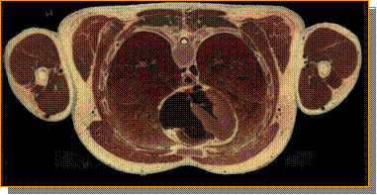
PAN tech and Standards cont’
Bluetooth
Short distance – usually up to 5 meters
Device is master or slave
Master grants permission to slave
Data rate is up to 721Kbps
UWB (Ultra-wide band) – PC peripherals, radar, imaging
Wide spectrum of frequencies
Short distance (2 to 10 meters)
Data rate 110Mbps at 10 meters, up to 500 at 2 meters

Slide 23
PAN tech and Standards cont’
Zigbee
Wireless standard for remote control, not data
Industry/home automation
3 frequencies (868 MHz, 915 MHz, and 2.4 GHz)
Data rate 20, 40, 250Kbps
Low power consumption
Three levels of security

Slide 24
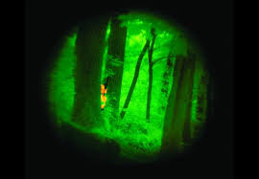
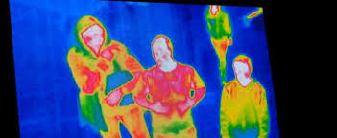
Other Short Distance Comm. Tech.
InfraRED – wavelength longer than visible light
The Infrared data association (IrDA) has a set of standards
Data rates between 2.4Kbps(control) and 16Mbps(data)
Range of 1 to several meters
Military: target acquisition, surveillance, night vision
Civilian: remote temperature sensing, remote control

Slide 25
Other Short Distance Comm. Tech. cont’
Radio Frequency Identification (RFID) - A small tag contains ID info and a receiver can “pull” from the tag
Over 140 RFID standards exist
Passive RFID draw power from the signal sent by the reader
Uses frequencies from less than 100MHz to 868-954MHz
Uses for inventory, sensors, passports, etc

Slide 26
Other Short Distance Comm. Tech. cont’
Radio Frequency Identification (RFID)
A small tag contains identification information
Some features of RFID:
Over 140 RFID standards exist for a variety of applications
Passive RFIDs draw power from the signal sent by the reader
Active RFIDs contain a battery (last up to 10 years)
Limited distance
Passive: 2ft ~ 20ft
Active : up to 1500ft
Frequencies from less than 100 MHz to 868-954 MHz
Used for inventory control, sensors, passports, and other applications

Slide 27
Wireless WAN Technologies
Wireless WAN technologies can be divided into two categories:
Cellular communication systems
Satellite communication systems

Slide 28
Wireless WAN Technologies - Cellular Communication Systems
voice services to mobile customers
interconnect cells to the public telephone
cellular systems provide data services and Internet connectivity
In terms of architecture
each cell contains a tower
a group of (usually adjacent) cells is connected to a Mobile Switching Center (MSC)
The center tracks a mobile user
manages handoff

Slide 29
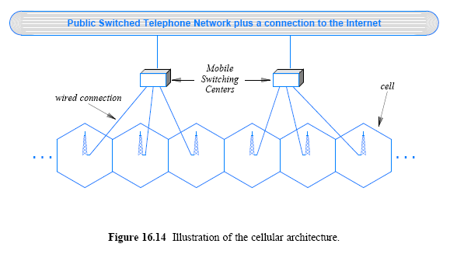
Cellular Communication Systems

Slide 30
Cellular Communication Systems
Perfect cellular coverage occurs if each cell is a hexagon
the cells can be arranged in a honeycomb
In practice, cellular coverage is imperfect
Most cell towers use omnidirectional antennas
transmit in a circular pattern
obstructions and electrical interference can attenuate a signal or cause an irregular pattern

Slide 31
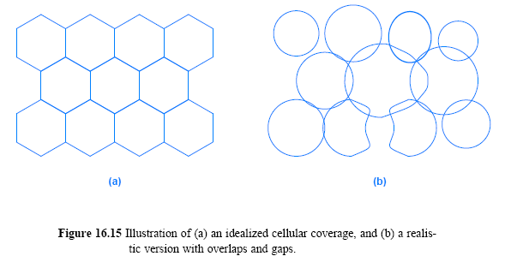
Variability in cell density (urban, rural setting)

Slide 32
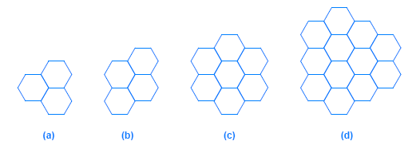
Cell Clusters and Frequency Reuse
Cellular communication follows a key principle:
an adjacent pair of cells do not use the same frequency
To implement the principle
A cluster approach
a small pattern of cells
clusters of size 3, 4, 7, and 12 that are commonly used

Slide 33
Cell Clusters and Frequency Reuse
Clusters can cover an entire area without leaving any gaps
each cell is assigned a unique frequency
adjacent cells will not have the same frequency
Figure 16.17 illustrates a replication of the 7-cell cluster

Slide 34
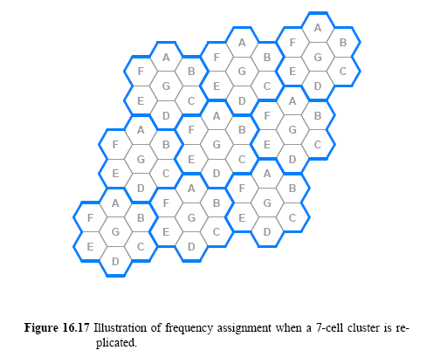

Slide 35
Generations of Cellular Technologies
Four generations in cellular technologies
1G, 2G, 3G, 4G, and 5G
intermediate versions: 2.5G and 3.5G
1G
Began in the late 1970s, and extended through the 1980s
Originally called cellular mobile radio telephones
used analog signals to carry voice
2G and 2.5G
Began in the early 1990s and continues to be used
2G uses digital signals to carry voice
2.5G
some 3G features

Slide 36
Generations of Cellular Technologies
3G and 3.5G
Began in the 2000s
higher-speed data services
download rates of 400 Kbps to 2 Mbps,
web browsing and photo sharing
roam across the world
4G
Began around 2008 – “IMT-Advanced” by ITU-R
Support for real-time multimedia
100Mbps while moving rapidly, 1Gbps while moving slowly
All-IP based mobile broadband
multiple connection technologies
Wi-Fi and satellite
5G
Peak data rate of 10Gbps but typically 100Mbps and 1 Gbps
Low latency – under 1 millisecond
Support 100 times more devices per square kilometer than 4G
Network slicing

Slide 37
Generations of Cellular Technologies
A variety of standards have evolved
The European Conference of Postal and Telecommunications Administrators selected Global System for Mobile Communications (GSM)
Motorola invented a TDMA system known as iDEN
Most US and Asian carriers adopted a CDMA approach that was standardized as IS-95A
Japan created a TDMA technology known as PDC (personal digital cellular)

Slide 38
Approach/classification | Standard
GSM (a TDMA technology) | GSM, FPRS, EDGE, EDGE Evolution, HSCSD
CDMA | IS-95A, IS-95B (extended to produce CDMA2000)
TDMA | iDEN, IS-136, POC (push-to-talk over cellular)
WCDMA | UMTS, HSDPA
Can be advertised as 4G | HSPA+, HTC EVO 4G, WiMAX
Adheres to IMT-Advanced | LTE Advanced, WiMAX advanced
4th generation cellular wireless standards

Slide 39
Generations of Cellular Technologies
Basic communication mechanism
General Packet Radio Service (GPRS) for Internet access
For 2G and 3G GSM, packet oriented best effort, 56-114 kbps
Short Message Service (SMS) is used for texting
Wireless Application Service (WAP) is used to access Internet
WAP browser for cell phones, email, stocks, sports, etc
Multimedia Messaging service (MMS) is used for multi-media
GPRS technologies evolved further (higher data rate):
Enhanced Data rate for GSM Evolution (EDGE)
known as Enhanced GPRS (EGPRS)
EDGE Evolution, 236.8 kbps
For any packet switched application

Slide 40
Generations of Cellular Technologies
Interoperability
A few key standards from 2G
IS-136, PDC, IS-95A, and EDGE all influenced the design of UMTS, a technology that uses Wideband CDMA (WCDMA)
IS-95B was extended to produce CDMA 2000
Standards for 3G data services
EVDO (Evolution Data Optimized or Evolution Data Only) and EVDV
Combined CDMA and FDM
High-Speed Downlink Packet Access (HSDPA) offers download speeds of 14 Mbps

Slide 41
VSAT Satellite Technology
The key to satellite communication is a parabolic dish antenna
Very Small Aperture Terminal (VSAT) allows two-way satellite communication (mostly 75cm ~ 1.2m)
Electromagnetic energy arriving from a distant satellite is reflected to a single focus point
By aiming the dish at a satellite (geosynchronous) and placing a detector at the focus point

Slide 42
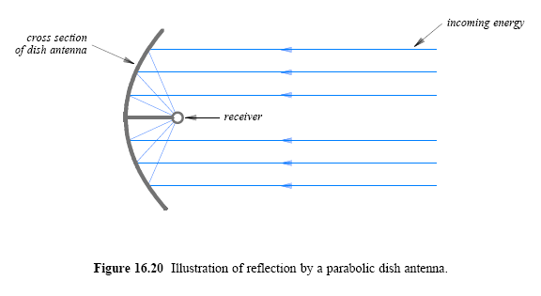

Slide 43
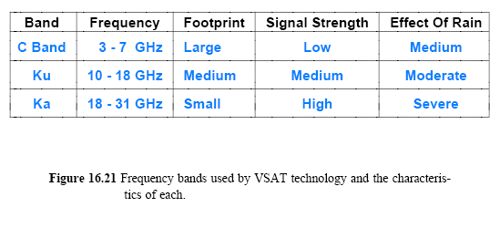
VSAT Satellite Technology
VSAT satellites use three frequency ranges that differ in
the strength of the signal delivered
the sensitivity to rain and other atmospheric conditions
the area of the earth's surface covered (satellite's footprint)

Slide 44
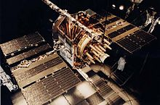
GPS Satellites
Global Positioning System (GPS)
Navigation, location-based services (LBS) for POI
The key features are:
Accuracy between 2-20 meters
24 total satellites orbit the earth
Satellites arranged in six (6) orbital planes
Provides time synchronization
Obtaining position information
All GPS satellites orbit in well-known positions
Use the distance to three satellites
NAVSTAR GPS satellite

Slide 45
Software Radio and the Future of Wireless
Special-purpose radio hardware
The antenna, transmitter, and receiver in a given device using predetermined frequencies
A cell phone with GSM, Wi-Fi, and CDMA
Must have three completely separate radio systems
Traditional radios are being replaced by radios that follow a programmable paradigm
Features are controlled by software running on a processor

Slide 46
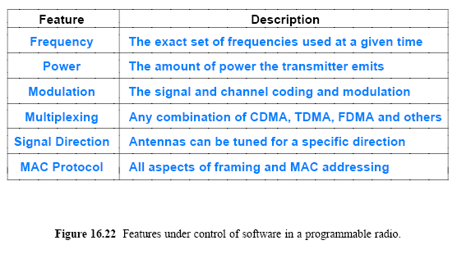
Software Radio and the Future of Wireless

Slide 47
Software Radio and the Future of Wireless
The key technologies:
Tunable analog filters and multiple antenna management
Analog chips -> tunable analog filters
Digital Signal Processors (DSPs)
Multiple-Input Multiple-Output (MIMO)
multiple antennas for both transmission and reception => spatial multiplexing
Universal Software Radio Peripheral (USRP) and GNU Radio
Uses software defined components such as mixers, filters, amplifiers, modulators/demodulators, detectors, etc.

